Slide 1

Intelligent Bug Detection and Code Clone Identification Using Hybrid Analysis Techniques
Guide Name : Dr Aswathy Mohan
AM.EN.U4CSE22002(A.NAVEEN SAI )
AM.EN.U4CSE22223(G.RAGHUVEER)
AM.EN.U4CSE22230(CH.JASWANTH)
AM.EN.U4CSE22260(Y.HARSHITH)

Slide 2
Outline
Introduction
Problem Definition
Literature Review Summary
Research Gap
Design/ Architecture
Algorithms
Result Analysis
Phase II plan
Reference
Approval from the Project Guide
Intelligent Bug Detection and Code Clone Identification Using Hybrid Analysis Techniques

Slide 3
Introduction
Modern software projects struggle to maintain code quality as they grow
Increase in complexity leads to more bugs and redundant code
Projects accumulate technical debt over time
The proposed system provides an automated solution to detect:
    Bugs
    Code clones
Target Audience:
Software Developers • DevOps Engineers • Project Managers
What is Bug Detection?
Identifies defects causing
unexpected software behavior
Traditional approach:
Static linters (Checkstyle) → syntax/style issues only
What is Code Clone?
Code Clone is the duplication of code fragments within a program.
It reduces maintainability and may lead to bugs.
Intelligent Bug Detection and Code Clone Identification Using Hybrid Analysis Techniques

Slide 4
Problem Definition
Limitations of Existing Solutions:
Dynamic Analysis Tools
They can find real errors when the code actually runs.
But they are very slow.
They need the program to run with test inputs.
They check only the paths that are executed, not all paths.
They find crashes but cannot tell the reason behind the bug.
Static Analysis Tools
They are fast and can check the whole code.
But they show many false warnings.
They cannot see how the program runs, only the text of the code.
They miss deep meaning-based bugs (Type-4 clones) because they only look at code shape, not logic.
Big software has millions of lines, so checking everything by hand is not possible.
Developers sometimes copy and paste code, which creates repeated code and mistakes.
Some bugs are not visible because the code runs, but it gives wrong output in some cases.
Normal tools only check basic errors (like spelling in code), so they miss deeper mistakes.
These hidden mistakes become silent bugs that slowly damage the software quality.
Intelligent Bug Detection and Code Clone Identification Using Hybrid Analysis Techniques

Slide 5
Problem Definition (Continues…)
Our Multi-Modal Solution Combines:
  Structural Signal (AST): Finds structural similarity; good for Type 1–3 clones.
  Semantic Signal (LLM Embeddings): Understands logic and meaning; detects Type-4 clones.
Dynamic Signal (Behavior Traces via BCI(Bytecode Instrumentation)):
  Verifies how code behaves at runtime.
Key Innovations:
  LLM-generated embeddings allow logic-level similarity detection, even with different syntax.
  Bytecode Instrumentation enables exact runtime behavior capture.
  Fusion Scoring blends structural, semantic, and behavioral signals for extremely low false positives.
  System flags a clone or bug only when all three signals agree, ensuring high accuracy.
Intelligent Bug Detection and Code Clone Identification Using Hybrid Analysis Techniques

Slide 6
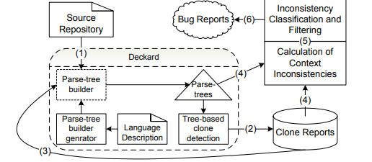
Literature Review Summary
Title: Context-Based Detection of Clone-Related Bugs
Jiang et al. 2007, ESEC/FSE^{[5]}
/* File: linux-2.6.19/drivers/scsi/arm/eesox.c */
if (length >= 9 && strncmp(buffer, "EESOX SCSI", 9) == 0) {
buffer += 9;
length -= 9;
if (length >= 5 && strncmp(buffer, "term=", 5) == 0) {
....
} else {
ret = -EINVAL;
}
} else {
ret = -EINVAL;
}
Uses a tree-based clone detection tool to find similar code pieces.
Then it checks if the surrounding context (like if, for, conditions) is inconsistent.
Detects bugs caused by copy–paste mistakes.
Tells the developer: “These two lines are similar but used differently → possible bug.”
Intelligent Bug Detection and Code Clone Identification Using Hybrid Analysis Techniques

Slide 7
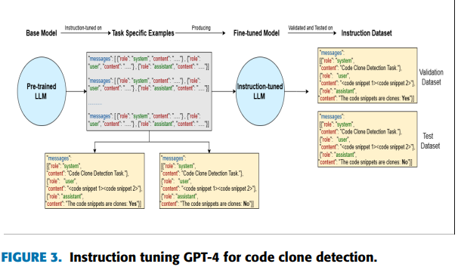
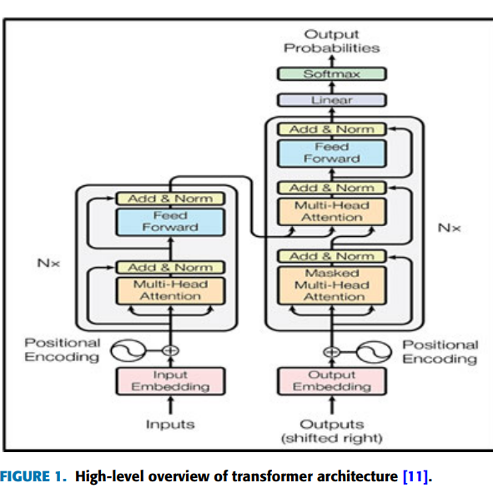
Literature Review Summary
Title: Code Clone Detection Techniques Based on Large Language Models
Afnan A. Almatrafi et al, IEEE Access, 2025 ^{[4]}
Detects semantic clones, including Type-4 (different syntax, same logic).
Works inside an IDE and gives:Real-time clone alerts
Uses GPT-3.5 and GPT-4 with few-shot instruction tuning.
Intelligent Bug Detection and Code Clone Identification Using Hybrid Analysis Techniques

Slide 8
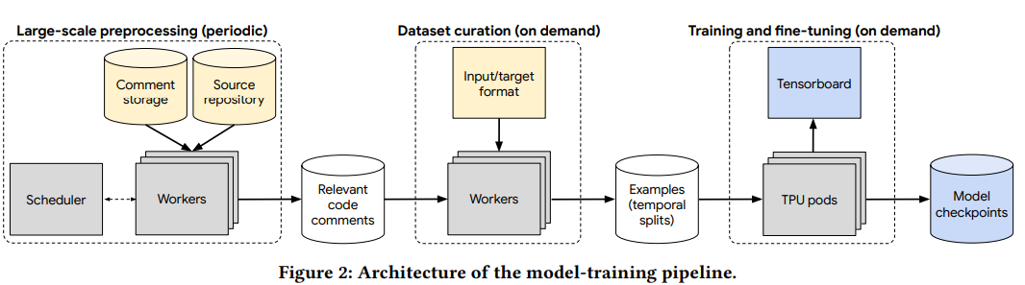
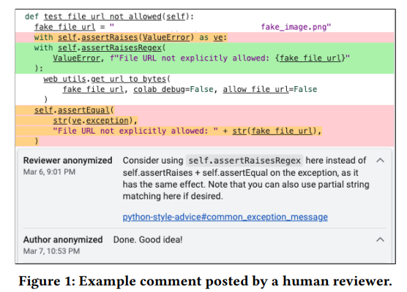
Literature Review Summary
Title: AI-Assisted Assessment of Coding Practices in Modern Code Review
M. Vijayvergiya et al ,2024,AI-Powered Software Engineering^{[2]}
Uses LLM-based best-practice checker trained using a pipeline.
A tool that automatically suggests:
  Better naming
  Cleaner code patterns
Intelligent Bug Detection and Code Clone Identification Using Hybrid Analysis Techniques

Slide 9
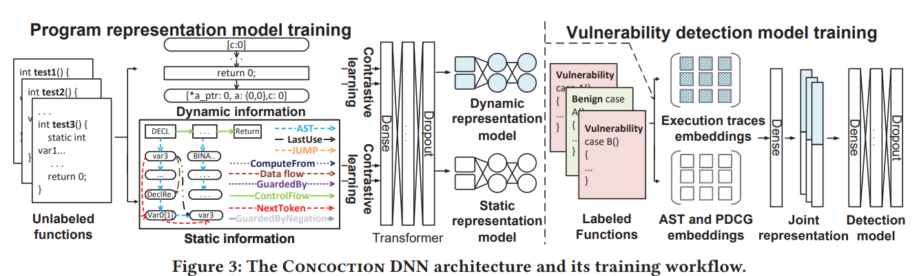
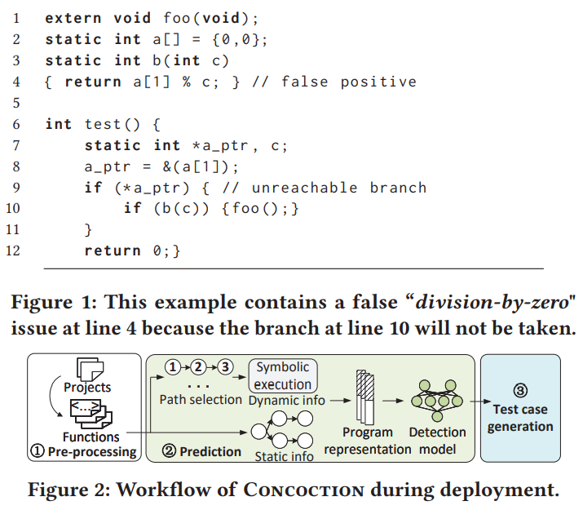
Literature Review Summary
Title: Combining Structured Static Code Information and Dynamic Symbolic Traces for Software Vulnerability Prediction
Huanting Wang et al,Conference on Software Engineering (2024)^{[3]}
Combines two types of program information:
  Static (AST, control-flow, data-flow)
  Dynamic (symbolic execution traces)
  Uses a Transformer model to learn code patterns.
Detects vulnerabilities in C programs.
Finds deep semantic bugs missed by static tools.
Intelligent Bug Detection and Code Clone Identification Using Hybrid Analysis Techniques

Slide 10
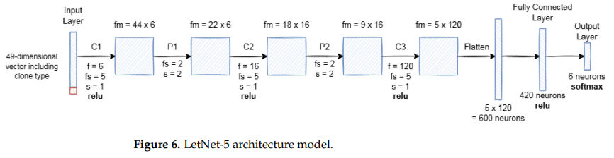
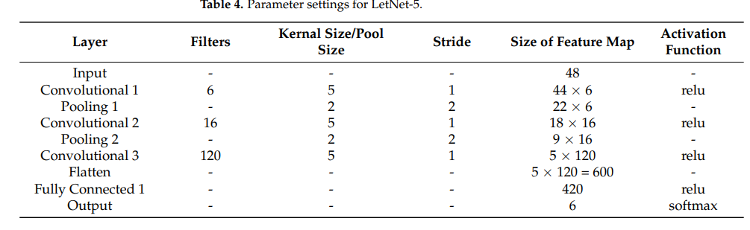
Literature Review Summary
LeONet: A Hybrid Deep Learning Approach for High-Precision Code Clone Detection Using Abstract Syntax Tree Features
T. Vijayanandan,2025,Big Data and Cognitive Computing^{[1]}
LetNet takes a 49-dimensional AST feature vector as input and uses three convolutional layers.
Detects Type 1, 2, and 3 clones with very high precision.
Gives the exact clone type and whether two fragments belong to the same clone family.
Intelligent Bug Detection and Code Clone Identification Using Hybrid Analysis Techniques

Slide 11
Literature Review Summary
Feature / Capability | AutoCommenter | Concoction | LeONet | Context-Based Bug Detection | LLM-CCD | Our Project
Bug Detection | Partial (review comments) | Yes | No | Yes (context only) | No | Yes (Semantic + Runtime)
Clone Detection | No | No | Yes | Yes (structural) | Yes | Yes (Type 1-4)
Semantic Clone Detection | No | No | Limited | No | Yes | Yes + Runtime validation
Dynamic Analysis | No | Yes | No | No | No | Yes (BCI + tests)
ML/LLM Usage | Yes | Yes | Yes | No | Yes | Hybrid ML + LLM + Dynamic
Clone related Bug Detection | No | No | No | Yes | No | Yes
Multi language Support | Limited | C only | Java only | C/Java only | Depends on prompts | High (Semantic Embeddings)
Industry Applicability | High | Medium | Low | Medium | Medium | High (CI/CD ready)
Intelligent Bug Detection and Code Clone Identification Using Hybrid Analysis Techniques

Slide 12
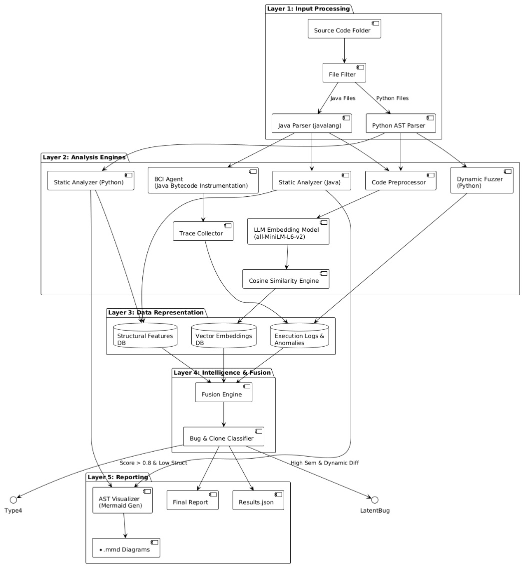
Design/Architecture
Input Processing
Source code is filtered and parsed (Java with javalang,
Python with AST parser) to extract basic code structure.
structure.
Analysis Engines
Static and dynamic analyzers study code patterns and \runtime behavior.
A BCI agent instruments Java, a fuzzer explores edge cases, and an LLM model creates code embeddings.
Similarity between code fragments is checked using cosine similarity.
Data Representation
All extracted information is stored as structural features, vector embeddings, and execution logs/anomalies.
Intelligence & Fusion
Static, dynamic, and semantic signals are fused.
A classifier detects inconsistent clones, semantic bugs, and abnormal code behavior.
Reporting
The system generates AST diagrams, final reports, result files, and flags high-risk code as latent bugs.

Slide 13
Algorithms
Static, Semantic & Dynamic Analysis
Static Analysis (Python & Java)
Parses code without executing it.
Python: Uses ast module to extract statements, branches, and detect rule-based bugs.
Java: Uses javalang + regex to count statements, branches, and catch common issues (e.g., empty catch blocks).
Semantic Analysis
Generates vector embeddings using Sentence-Transformers (MiniLM).
Measures cosine similarity to detect semantic clones.
Flags pairs with similarity ≥ 0.75.
Dynamic Analysis
Executes code multiple times (fuzzing style).
Captures stdout, stderr, exceptions, and non-zero return codes.
Detects anomalies like crashes, intermittent failures, timeouts, and resource errors.
Intelligent Bug Detection and Code Clone Identification Using Hybrid Analysis Techniques

Slide 14
Algorithms
Category | Sub-Module | Description / Checks Performed
Static Rule-Based Checks | Python (AST- Based) | Mutable default arguments Unused parameters Shadowed built-ins Unreachable code Empty/bare except blocks Suspicious comparisons ( == None , wrong types)
Static Rule-Based Checks | Java (Regex- Based) | == used for String comparison Empty catch blocks return inside finally Hardcoded credentials Use of System.exit()
Logical Checker | ___ | Contradictory conditions - Redundant conditions - Docstring vs implementation mismatch . Self-comparison bugs (x == x , x!=x )
Runtime Analyzer | ___ | Detects crashes/exceptions MemoryError n NullPointerException , etc.) Infinite loops Timeouts General runtime failure reporting
Intelligent Bug Detection and Code Clone Identification Using Hybrid Analysis Techniques

Slide 15
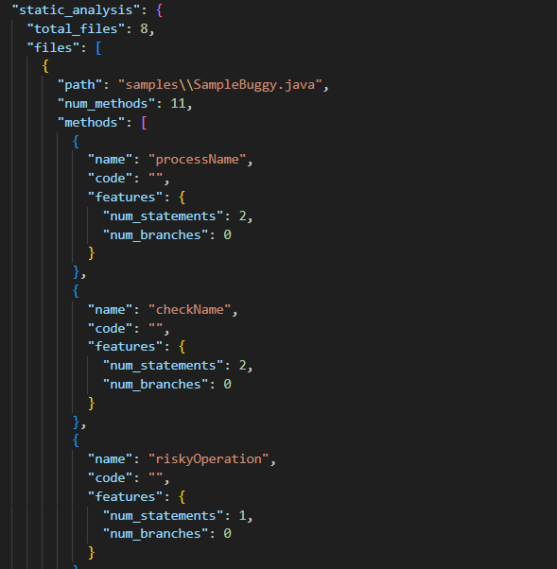
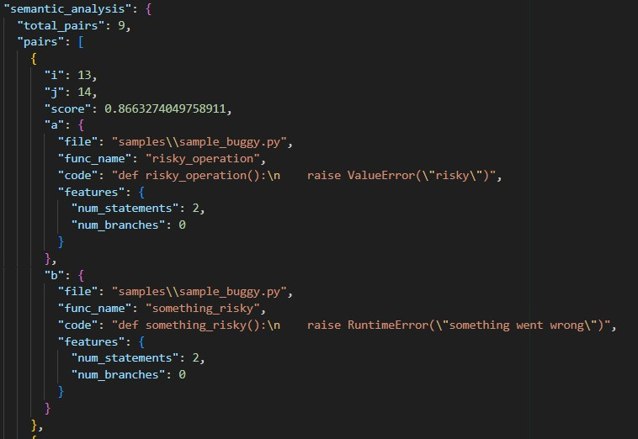
Result Analysis
  Semantic Analysis Output :
The system utilized a combination of semantic embeddings and structural feature similarity to identify meaningful relationships between code fragments. Instead of relying on true execution-level call tracing, the prototype employs embedding-based pairing and lightweight fuzzing feedback to approximate how functions may concep- tually relate or behave similarly.
  Static Analysis Output :
The static analysis module successfully parsed all Python and Java files, extracting Abstract Syntax Tree features, function/method definitions, structural metrics such as branching complexity, and lexical patterns. The system analyzed 8 files and extracted 46 unique function or method snippets. This confirms that the parser works reliably across mixed-language environments and provides a stable foundation for semantic and dynamic modules.
Intelligent Bug Detection and Code Clone Identification Using Hybrid Analysis Techniques

Slide 16
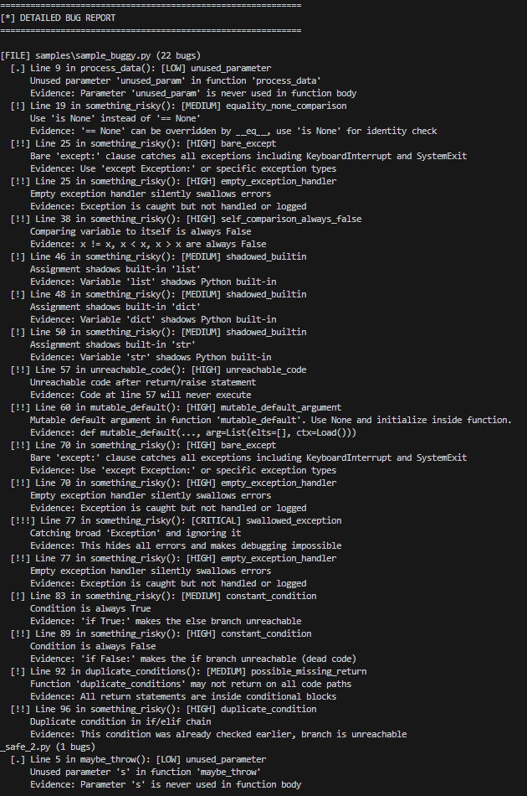
Result Analysis
  Bug Detection Report :
The system generated comprehensive, human-interpretable bug reports that categorize findings across critical, high, medium, and low severity levels. Each detected issue is accompanied by contextual evidence, including file location, line number, triggering code patterns, and the specific rule or anomaly responsible for the detection. By combining static rule violations, logical-consistency checks, and signals from dynamic anomaly analysis, the reports provide developers with actionable explanations rather than raw alerts. This level of detail ensures that the output is suitable for real debugging workflows, automated documentation, and further refinement in continuous integration environments.
Intelligent Bug Detection and Code Clone Identification Using Hybrid Analysis Techniques

Slide 17
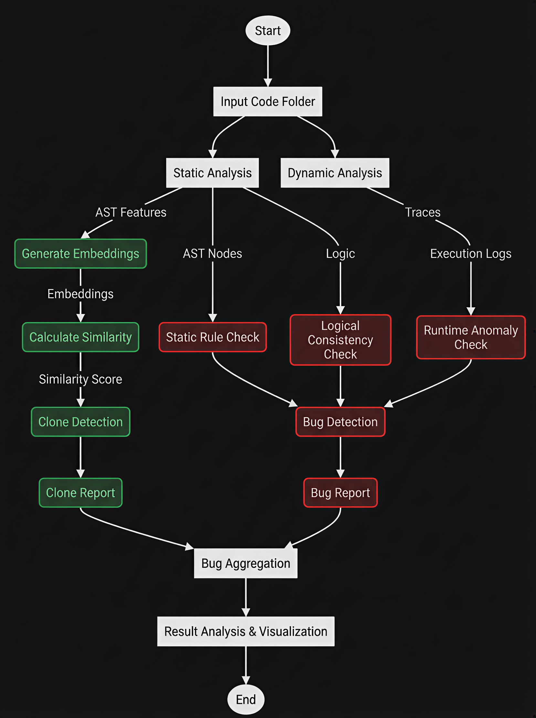
Result Analysis
Visual Diagram Output :
The system generated visualization outputs that include snippet-level similarities, pipeline execution logs, and summary breakdowns. These visuals assist developers in understanding the high-level behavior of the analysis pipeline, the distribution of clone pairs, and anomaly patterns.
Intelligent Bug Detection and Code Clone Identification Using Hybrid Analysis Techniques

Slide 18
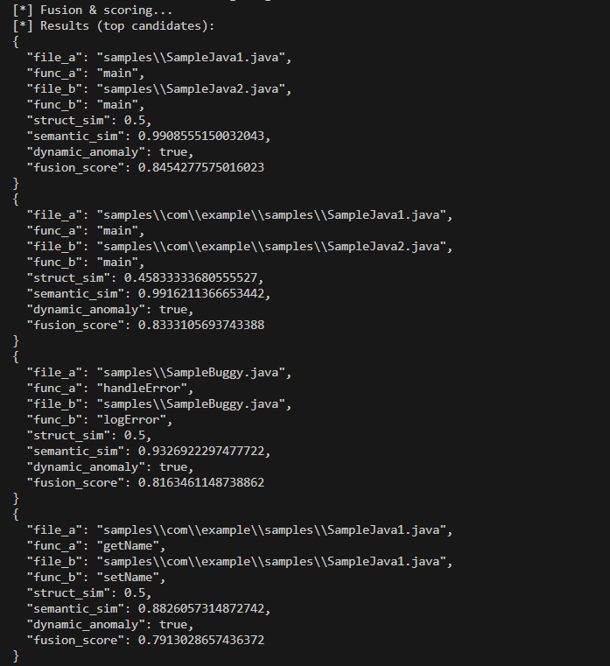
Result Analysis
  Fused Static–Semantic–Dynamic Representation :
The core innovation of the system is its fusion engine, which combines structural similarity, embedding similarity, and dynamic anomaly signals. This fusion process produced 283 ranked clone and bug-likelihood reports. The highest-confidence can- didates had fusion scores above 0.80, demonstrating strong multi-modal alignment.
  Dynamic Execution Trace Output :
Intelligent Bug Detection and Code Clone Identification Using Hybrid Analysis Techniques

Slide 19
Phase II plan
Automated Bug Repair :
System will autosuggest fixes for detected logical bugs using program synthesis and pattern-based corrections.
IDE Integration (VS Code Plugin) :
Realtime bug detection, clone alerts, and suggestion popups directly inside the developer’s coding environment.
Advanced Graph Analysis :
Use Code Property Graphs and Graph Neural Networks for deeper semantic understanding and more accurate bug/clone prediction.
Interactive Web Dashboard :
Visualize bug hotspots, clone clusters, execution traces, and ProjectWise code health metrics with intuitive analytics.
Intelligent Bug Detection and Code Clone Identification Using Hybrid Analysis Techniques

Slide 20
References
1] T. Vijayanandan, K. Banujan, A. Induranga, B. T. G. S. Kumara, and K. Koswattage, “LeONet: A Hybrid Deep Learning Approach for High-Precision Code Clone Detection Using Abstract Syntax Tree Features,” Big Data and Cognitive Computing, 2025.
[2] M. Vijayvergiya, M. Salawa, I. Budiselić, D. Zheng, P. Lamblin, M. Ivanković, J. Carin, M. Lewko, J. Andonov, G. Petrović, D. Tarlow, P. Maniatis, and R. Just, “AI-Assisted Assessment of Coding Practices in Modern Code Review,” AI-Powered Software Engineering (AIware), 2024.
[3] H. Wang, Z. Tang, S. H. Tan, J. Wang, Y. Liu, H. Fang, C. Xia, and Z. Wang, “Combining Structured Static Code Information and Dynamic Symbolic Traces for Software Vulnerability Prediction,” ICSE, 2024.
[4] A. A. Almatrafi, F. A. Eassa, and S. A. Sharaf, “Code Clone Detection Techniques Based on Large Language Models,” IEEE Access, 2025.
[5] L. Jiang, Z. Su, and E. Chiu, “Context-Based Detection of Clone-Related Bugs,” ESEC/FSE, 2007.
Intelligent Bug Detection and Code Clone Identification Using Hybrid Analysis Techniques

Slide 21
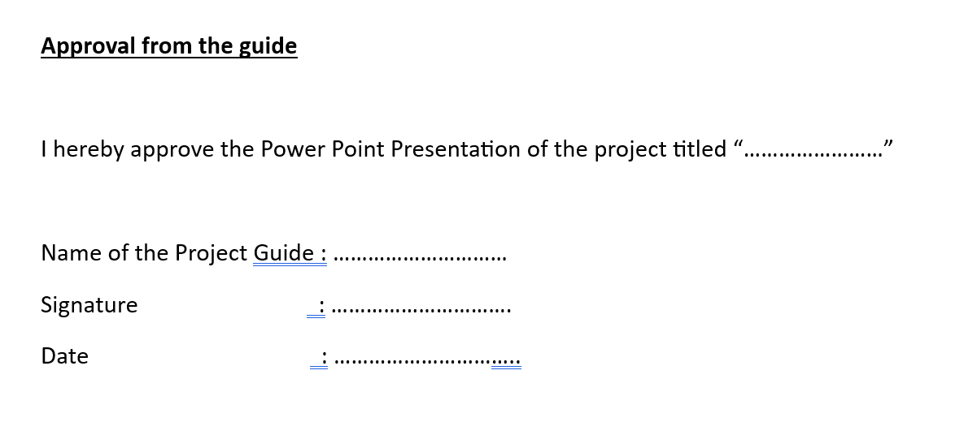
Approval from the project guide
Intelligent Bug Detection and Code Clone Identification Using Hybrid Analysis Techniques

